Slide 1
Embedded OS
File Systems
2021年12月
Embedded System

Slide 2
File Systems
Linux 离不开文件系统，Linux 的程序和文件都是保存在文件系统中的。
One of the most important decisions an embedded developer makes is which file system(s) to deploy.
Some file systems optimize for performance,Some optimize for size. Still others optimize for data recovery after device or power failure.
This chapter introduces the major file systems in use on Linux systems and examines the characteristics of each as they apply to embedded designs.
Embedded System

Slide 3
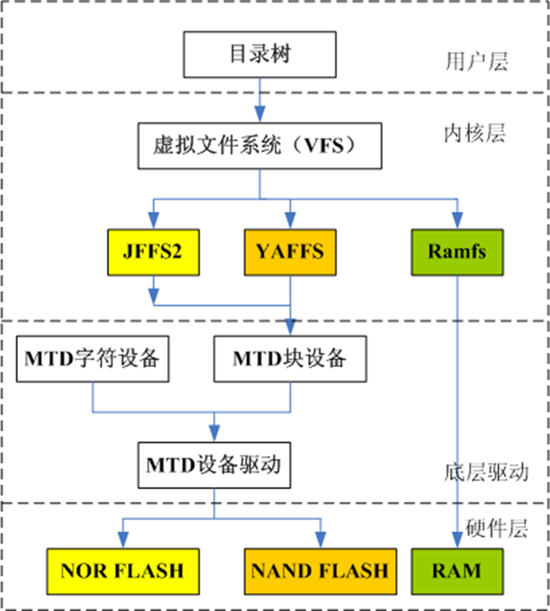
File Systems Architecture
Embedded System

Slide 4
File Systems
Linux启动时，第一个必须挂载的是根文件系统；若系统不能从指定设备上挂载根文件系统，则系统会出错而退出启动。之后可以自动或手动挂载其他的文件系统。因此，一个系统中可以同时存在不同的文件系统。
不同的文件系统类型有不同的特点，因而根据存储设备的硬件特性、系统需求等有不同的应用场合。在嵌入式Linux应用中，主要的存储设备为RAM(DRAM, SDRAM)和ROM(常采用FLASH存储器)，常用的基于存储设备的文件系统类型包括：jffs2, yaffs, cramfs, romfs, ramdisk, ramfs/tmpfs等。
Embedded System

Slide 5
Linux File System Concepts
Before delving into the details of the individual file systems, let’s look at the big picture of how data is stored on a Linux system.
File systems are base on block devices.
In general, character devices store and retrieve data in serial streams. In contrast, block devices store and retrieve data in equal-sized chunks of data at a time, in random locations on an addressable medium.
Embedded System

Slide 6
Partitions
Partitions--the logical division of a physical device on which a file system exists.
A partition is a logical division of the physical medium (hard disk, Flash memory) whose data is organized following the specifications of a given partition type.
A physical device can have a single partition covering all its available space, or it can be divided into multiple partitions to suit a particular task.
A partition can be thought of as a logical disk onto which a complete file system can be written.
Embedded System

Slide 7

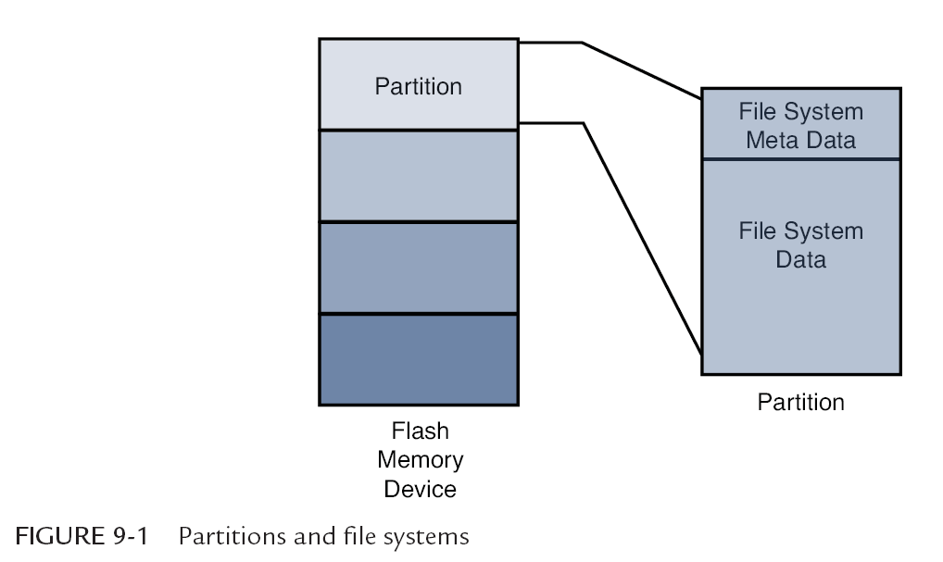
The relationship between partitions and file systems.
Embedded System

Slide 8
Partitions and fdisk utility
Linux uses a utility called fdisk to manipulate partitions on block devices.
A recent fdisk utility found on many Linux distributions has knowledge of more than 90 different partition types.
In practice, only a few are commonly used on Linux systems.
Some common partition types are Linux, FAT32, and Linux Swap.
Embedded System

Slide 9
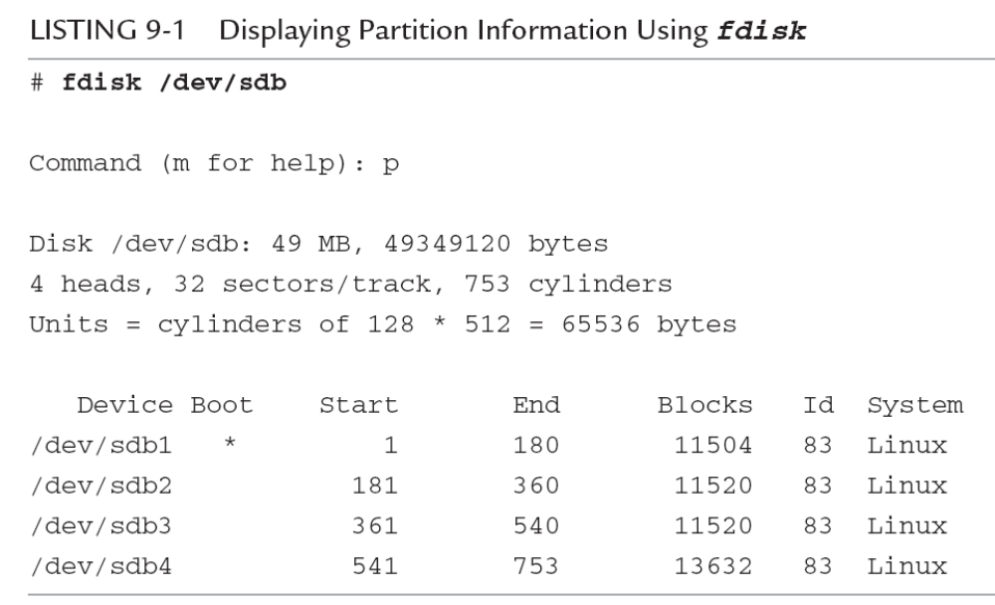
Fdisk
Embedded System

Slide 10
ext2
EXT2（The Second Extended Filesystem）和EXT3（The Third Extended Filesystem）是Linux 内核自己的文件系统。
EXT2 发布于1993 年1 月，它是由R\'emy Card、Theodore Ts'o和Stephen Tweedie编写的，它是EXT文件系统重写的版本
EXT2与传统的Unix文件系统有许多共性，都有块（block）、节点（inode）和目录（directory）的概念。尽管没有实现访问控制列表（ACL）、碎片、恢复删除文件和压缩功能，但是都预留了空间。
Embedded System

Slide 11
format the partitions
Building on Listing 9-1, we need to format the partitions created with fdisk. To do so,we use the Linux mkfs.ext2 utility.
This utility makes a file system of type ext2 on the specified partition.
Listing 9-2 contains much detail relating to the ext2 file system. It’s an excellent way to begin understanding the operational characteristics of ext2.
Embedded System

Slide 12
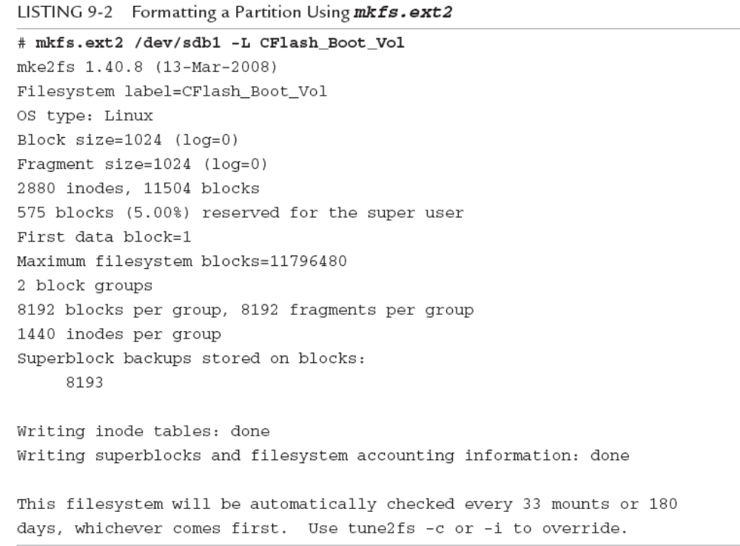
Embedded System

Slide 13
block size
mkfs.ext2 can be instructed to format an ext2 file system with different block sizes. Current implementations allow block sizes of 1,024, 2,048, and 4,096 bytes.
Block size is always a compromise for best performance.Large and small each have shortcomings
Benchmark testing on your particular hardware implementation and data formats is the only way to be sure you have selected an optimum block size.
Embedded System

Slide 14
Mounting a File System
After a file system has been created, we can mount it on a running Linux system.
  # mount /dev/sdb1 /mnt/flash
The mount command has many options. Several options that mount accepts depend on the target file system type.
Most of the time, mount can determine the type of file system on a properly formatted file system known to the kernel.
Embedded System

Slide 15
Checking File System Integrity
The e2fsck command is used to check the integrity of an ext2 file system.
A file system can become corrupted for several reasons. By far the most common reason is an unexpected power failure.
In the embedded systems, unexpected power-downs are common, so we need to provide some defensive measures against these cases. e2fsck is our first line of defense.
Embedded System

Slide 16
Checking File System Integrity
Listing 9-4 shows the output of e2fsck run on our CompactFlash from the previous examples. It has been formatted and properly unmounted, so no errors should occur.
LISTING 9-4 Clean File System Check
  # e2fsck /dev/sdb1
  e2fsck 1.40.8 (13-Mar-2008)
  CFlash_Boot_Vol: clean, 11/2880 files, 471/11504 blocks
e2fsck should be run only on an unmounted file system.
Embedded System

Slide 17
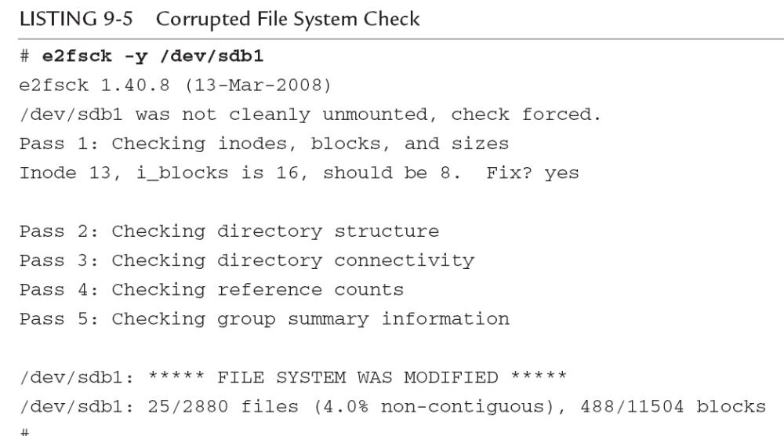
Checking File System Integrity
Embedded System

Slide 18
Checking File System Integrity
Some types of file system errors cannot be repaired using e2fsck.
Moreover, the embedded system designer should understand that if power has been removed without proper shutdown, the boot cycle can be delayed by the length of time it takes to scan your boot device and repair any errors.
Embedded System

Slide 19
Checking File System Integrity
Another defense against file system corruption is to ensure that writes are committed to disk immediately when written
The sync utility can be used to force all queued I/O requests to be committed to their respective devices.
Deferring disk writes is a performance optimization used in all modern operating systems. Using sync effectively defeats this optimization
Embedded System

Slide 20
ext3 file system
The ext2 file system has matured as a fast, efficient, and robust file system for Linux systems. However, if you need the additional reliability of a journaling file system, or if boot time after unclean shutdown is an issue in your design, you should consider the ext3 file system.
The ext3 file system has become a powerful, high-performance, and robust journaling file system.
It is currently the default file system for many popular desktop Linux distributions.
Embedded System

Slide 21
ext3 file system
The ext3 file system is basically an extension of the ext2 file system with added journaling capability.
Journaling is a technique in which each change to the file system is logged in a special file so that recovery is possible from known journaling points.
One of the primary advantages of the ext3 file system is its ability to be mounted directly after an unclean shutdown.
Embedded System

Slide 22
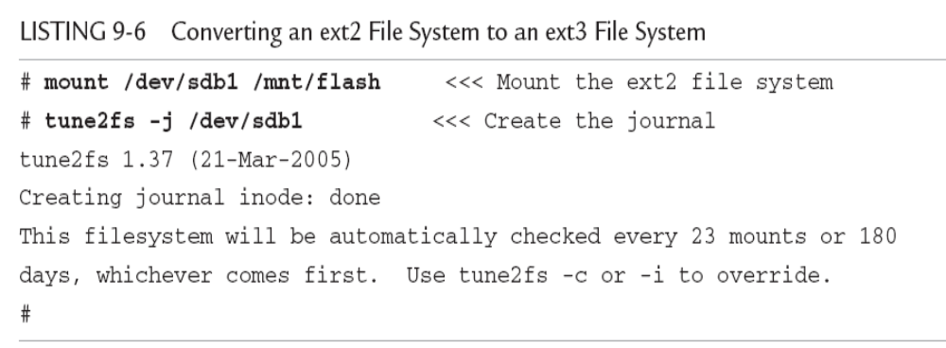
ext3 file system
One of the most significant design goals for the ext3 file system was that it be both backward- and forward-compatible with the ext2 file system.
Embedded System

Slide 23
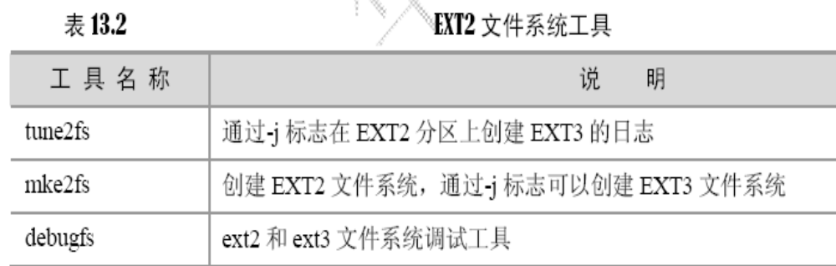
ext3 file system
EXT3 文件系统完全兼容EXT2，EXT2 分区可以挂接成EXT2 格式。EXT2 分区可以通 过tune2fs命令转换成EXT3 格式。
Embedded System

Slide 24
ext4
The ext4 file system builds on the success of the ext3 file system.Like its predecessor,it is a journaling file system.
It was developed as a series of patches designed to remove some of the limitations of the ext3 file system. It is likely that ext4 will become the default file system for a number of popular Linux distributions.
The ext4 file system removed the 16-terabyte limit for file systems, increasing the size to 1 exbibyte (2⁶⁰ bytes, if you can count that high!) and supports individual file sizes up to 1024 gigabytes.
Embedded System

Slide 25
ext4
Several other improvements have been made to increase performance for the types of loads expected on large server and database systems, where ext4 is expected to be the default.
If your embedded system requirements include support for large, high-performance journaling file systems, you might consider investigating ext4.
Linux kernel 自 2.6.28 开始正式支持新的文件系统 Ext4
Embedded System

Slide 26
ReiserFS file system
The ReiserFS file system has enjoyed popularity among some desktop distributions such as SuSE and Gentoo.
Reiser4 is the current incarnation of this journaling file system.
Unlike ext3, Reiser4 has introduced an API for system programmers to guarantee the atomicity of a file system transaction.
For example : Database program
Reiser4 implements high-performance “atomic” file system operations designed to protect both the state of the file system (its consistency) and the data involved in a file system operation.
Embedded System

Slide 27
JFFS2 File System
Flash memory has been used extensively in embedded products
Because of the nature of Flash memory technology, it is inherently less efficient and more prone to data corruption caused by power loss. This is due to much larger write times.
The inefficiency stems from the block size. Block sizes of Flash memory devices are often measured in the tens or hundreds of kilobytes. Flash memory can be erased only a block at a time, although writes usually can be executed 1 byte or word at a time. To update a single file, an entire block must be erased and rewritten.
Embedded System

Slide 28
JFFS2 File System
It is well known that the distribution of file sizes on any given Linux machine (or other OS) contains many more smaller files than larger files. The histogram shown in Figure 9-2, generated with gnuplot, illustrates the distribution of file sizes on a typical Linux development system.
Embedded System

Slide 29
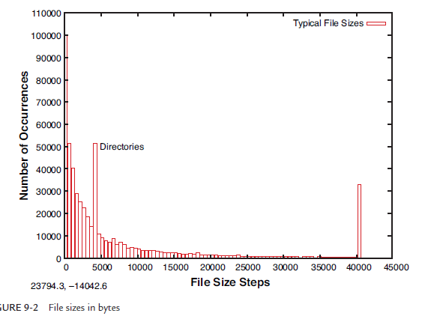
JFFS2 File System
Embedded System

Slide 30
JFFS2 File System
Small file sizes present a unique challenge to the Flash file system designer. Because Flash memory must be erased an entire block at a time, and the size of a Flash block is often many multiples of the smaller file sizes, Flash is subject to time-consuming block rewriting operations.
Because Flash writes can be time-consuming (much slower than hard disk writes),this increases the window where data corruption can occur due to a sudden loss of power.
Embedded System

Slide 31
JFFS2 File System
JFFS文件系统最早是由瑞典Axis Communications公司基于Linux2.0的内核为嵌入式系统开发的文件系统。JFFS2是RedHat公司基于JFFS开发的闪存文件系统，最初是针对RedHat公司的嵌入式产品eCos开发的嵌入式文件系统，所以JFFS2也可以用在Linux, uCLinux中。
JFFS和JFFS2 都是开源的日志文件系统，最适合在Flash芯片上使用。它们的日志结构能够保持文件系统的连续性。即使文件系统崩溃或者非正常掉电，重启的时候也不需要执行fsck。另外，它们还考虑了Flash存储介质的物理特点。
Flash memory has a limited lifetime.JFFS2 uses a technique called wear leveling to spread the writes evenly across the blocks of a Flash memory device.
Embedded System

Slide 32
JFFS2 File System
JFFS2 是JFFS的改进版。它在下列方面有些改进。
（1）了解和处理按照擦除扇区（Sector）级写Flash。这样做有各种好处，例如垃圾回收可以基于扇区而不是整个文件系统。
（2）能够标记坏块扇区并且继续使用剩余的好扇区，这样可以提高设备使用寿命。
（3）垃圾回收导致的阻塞时间更少。最小可以只擦除一个扇区，不像JFFS 需要把整个文件系统数据都压到垃圾回收区。
（4）文件系统设计就提供了本地数据压缩。
Embedded System

Slide 33
JFFS2 File System
JFFS2设计支持ROM、NOR Flash和NAND Flash芯片。支持磨损平衡，从而延长Flash寿命。运行时总是把Flash目录结构保存在RAM 中，提高系统性能。采用压缩的格式存储数据可以存储更多文件。
JFFSx不适合用于NAND闪存主要是因为NAND闪存的容量一般较大，这样导致JFFS为维护日志节点所占用的内存空间迅速增大，另外，JFFSx文件系统在挂载时需要扫描整个FLASH的内容，以找出所有的日志节点，建立文件结构，对于大容量的NAND闪存会耗费大量时间。
目前jffs3正在开发中。关于jffs系列文件系统的使用详细文档，可参考MTD补丁包中mtd-jffs-HOWTO.txt。
Embedded System

Slide 34
Building a JFFS2 image
Building a JFFS2 image is relatively straightforward.
Before proceeding,ensure that your kernel has support for JFFS2 and that your development workstation contains a compatible version of the mkfs.jffs2 utility. These utilities can be downloaded and built from source code, ftp://ftp.infradead.org/pub/mtd-utils/.
on Ubuntu, they can be installed by executing this command:
  $ sudo apt-get install mtd-tools
Embedded System

Slide 35
Building a JFFS2 image
JFFS2 images are built from a directory that contains the desired files on the file system image. Listing 9-8 shows a typical directory structure for a Flash device designed to be used as a root file system.
Embedded System

Slide 36
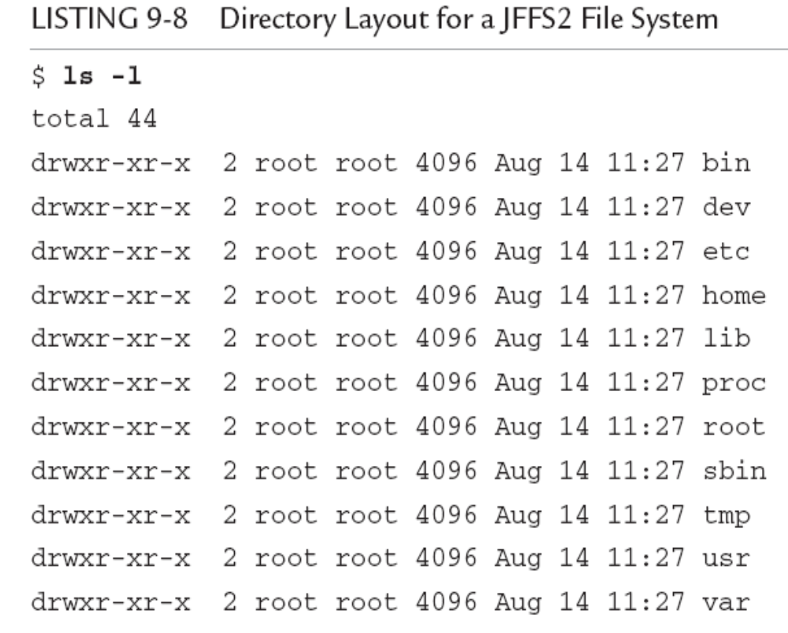
Embedded System

Slide 37
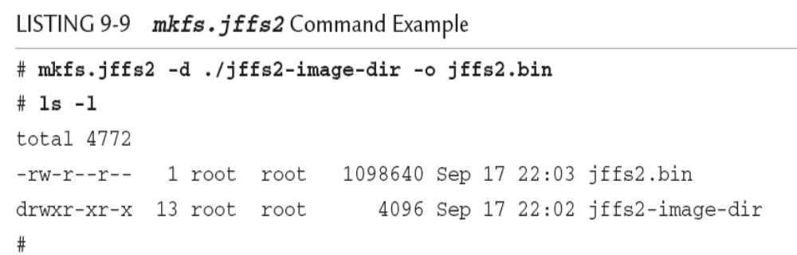
Building a JFFS2 image
Embedded System

Slide 38
Cramfs:Compressed ROM File System
From the README file in the cramfs project, the goal of cramfs is to “cram a file system into a small ROM.”
The cramfs file system is very useful for embedded systems that contain a small ROM or FLASH memory that holds static data and programs.
“cramfs is designed to be simple and small, and compress things well.”
The cramfs file system is read-only.
Embedded System

Slide 39
Cramfs:Compressed ROM File System
在cramfs文件系统中，每一页(4KB)被单独压缩，可以随机页访问，其压缩比高达2:1,为嵌入式系统节省大量的Flash存储空间，使系统可通过更低容量的FLASH存储相同的文件，从而降低系统成本。
Although somewhat limited in terms of maximum file sizes, maximum number of files, and so on, the cramfs file system is ideal for boot ROMs, in which read-only operation and fast compression are desirable features.
Embedded System

Slide 40
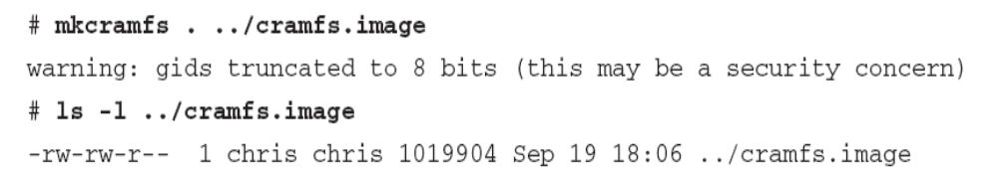
Cramfs:Compressed ROM File System
created with a command-line utility called mkcramfs
Embedded System

Slide 41
Cramfs:Compressed ROM File System
Note that if your kernel is configured with cramfs support, you can mount this file system image on your Linux development workstation and examine its contents. Of course, because it is a read-only file system, you cannot modify it.
Embedded System

Slide 42
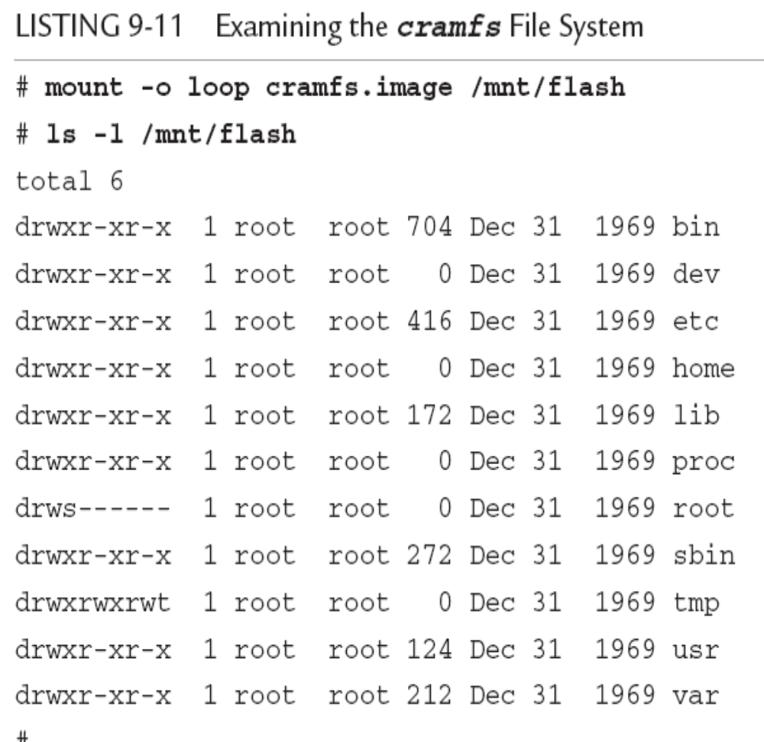
Embedded System

Slide 43
Cramfs
8bits group ID (GID)
Although somewhat limited in terms of maximum file sizes, maximum number of files, and so on, the cramfs file system is ideal for boot ROMs, in which read-only operation and fast compression are desirable features

Slide 44
NFS(Network File System)
NFS enables you to export a directory on an NFS server and mount that directory on a remote client machine as if it were a local file system.
NFS is useful in general for large networks of UNIX/Linux machines, and it can be a panacea to the embedded developer.
Using NFS on your target board, an embedded developer can have access to a huge number of files, libraries,tools, and utilities during development and debugging, even if the target embedded system is resource-constrained
Embedded System

Slide 45
NFS(Network File System)
NFS的配置
As with the other file systems, your kernel must be configured with NFS support,for both the server-side functionality and the client side.
1.服务器的配置:NFS服务器的配置文件exports,export文件在目录/etc/下，用于配置NFS服务器所提供的目录共享.exports文件默认设置为空，这也是出于安全性的考虑,exports(输出)文件要输出的共享目录 客户端主机地址(设置选项)
/home/share *(sync,ro)
共享目录:设置系统中需要为共享的目录路径
Embedded System

Slide 46
NFS
设置选项:sync设置NFS服务器同步写磁盘(async：资料会先暂存于内存当中，而非直接写入硬盘),ro设置输出的共享目录只读(与rw不能共同使用)
NFS服务器的启动与停止
启动NFS服务器
  #service portmap start
  #service nfs start
查询NFS服务器状态:
  #service portmap status
  #service nfs status
设置NFS服务器的自动启动状态
  #chkconfig --list portmap|nfs
  查看nfs服务的自动启动状态
Embedded System

Slide 47
NFS
NFS客户端配置
#mount 192.168.1.57:/home/public /mnt/nfshare
#mount |grep nfs查询该目录的挂载状态
#umount /mnt/nfshare卸载卸NFS共享目录
Embedded System

Slide 48
Root File system on NFS
Mounting your project workspace on your target embedded system is very useful for development and debugging because it facilitates rapid access to changes and source code for source-level debugging.
For development purposes, it can only increase productivity if your embedded system is loaded with all the tools and utilities you are familiar with on a Linux workstation
Embedded System

Slide 49
Root File system on NFS
Configuring your embedded system to mount its root file system via NFS at boot time is relatively straightforward. First, you must configure your target’s kernel for NFS support.
There is also a configuration option to enable root mounting of an NFS remote directory. This is illustrated in Figure 9-3.
Embedded System

Slide 50
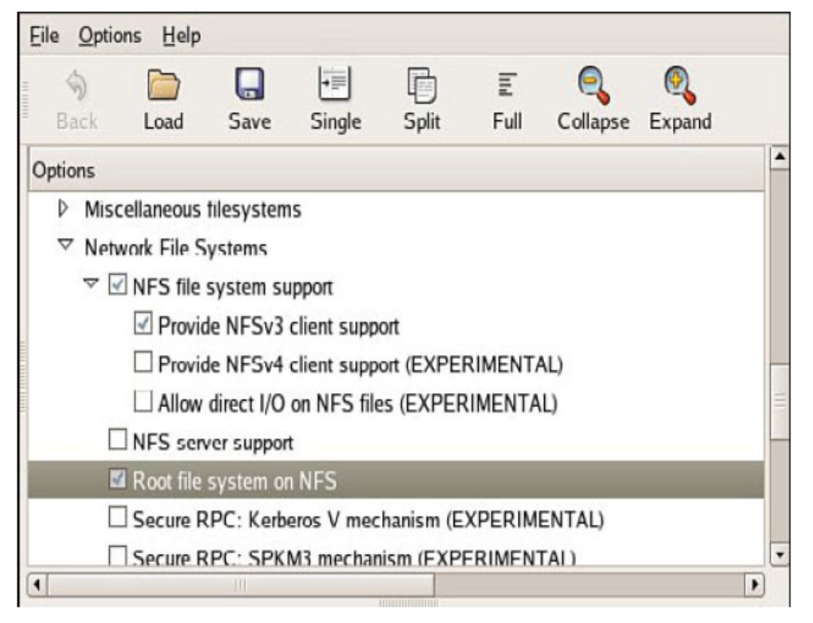
Embedded System

Slide 51
Root File system on NFS
After these kernel-configuration parameters have been selected ,all that remains is to somehow feed information to the kernel so that it knows where to look for the NFS server.
the kernel can be passed the proper parameters on the kernel command line to configure its IP port and server information on power-up. A typical kernel command line might look like this:
A typical kernel command line might look like this:
  console=ttyS0,115200 ip=bootp root=/dev/nfs
Embedded System

Slide 52
Root File system on NFS
This tells the kernel to expect a root file system via NFS and to obtain the relevant parameters (server name, server IP address, and root directory to mount) from a BOOTP server.
Embedded System

Slide 53
Pseudo File Systems
A number of file systems fall under the category of Pseudo File Systems in the kernel configuration menu. Together they provide a range of facilities useful in a wide range of applications.
Embedded System

Slide 54
/proc file system
an interface that allows the kernel to communicate information about each running process on a Linux system.
The /proc file system has become a virtual necessity for all but the simplest of Linux systems, even embedded ones.
Many user-level functions rely on the contents of the /proc file system to do their job.
For example, the mount command
Embedded System

Slide 55
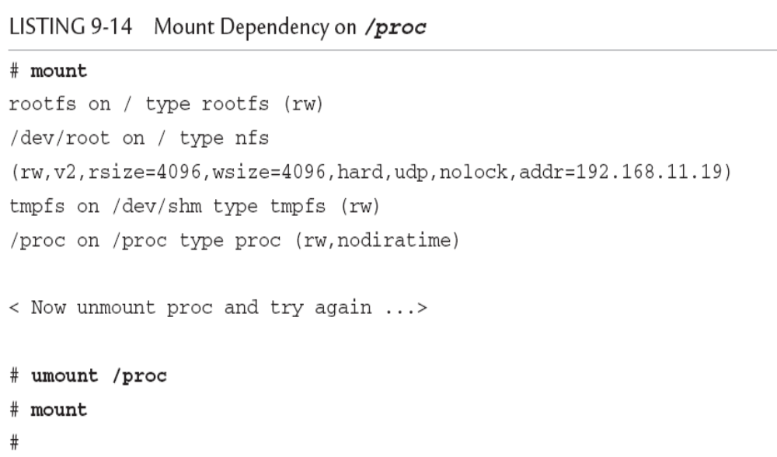
Embedded System

Slide 56
Mount the /proc
To mount the /proc file system, use the mount command, as with any other file system:
  $ mount -t proc /proc /proc
In the preceding invocation, we could have substituted none for /proc, as follows:
  $ mount -t proc none /proc
Embedded System

Slide 57
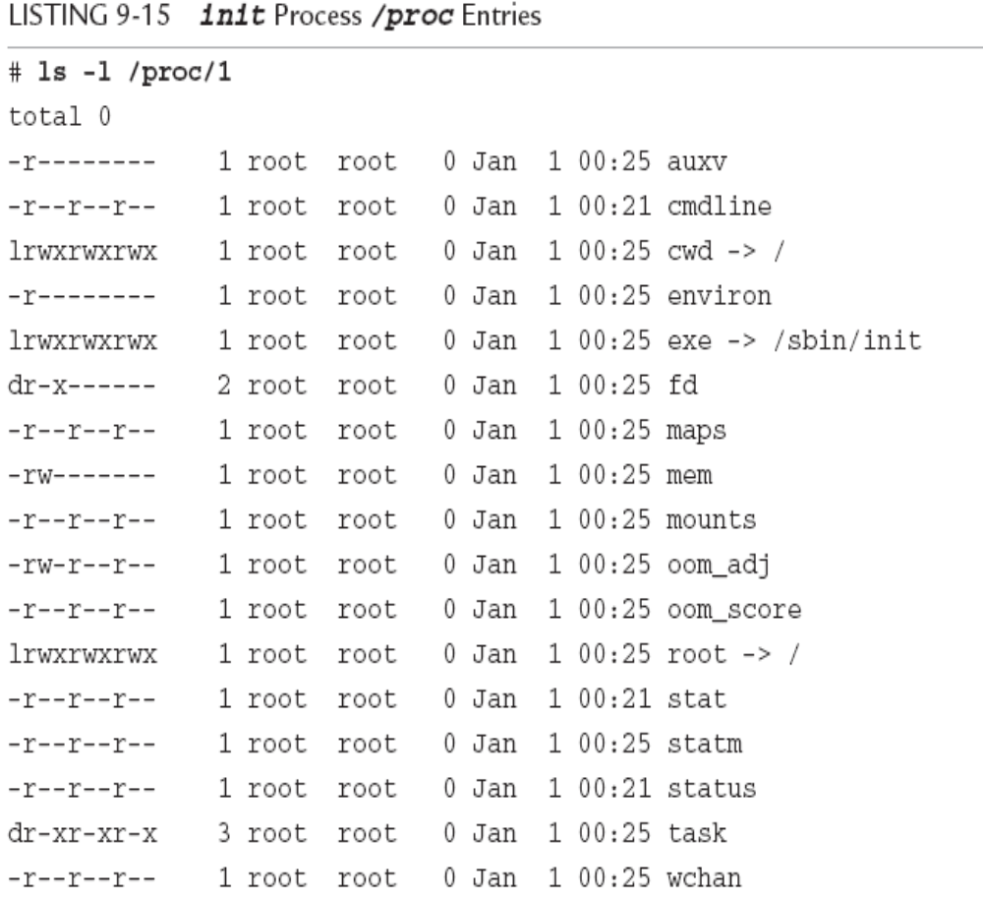
/proc file system
Each user process running in the kernel is represented by an entry in the /proc file system.
Embedded System

Slide 58
/proc file system
These entries, which are present in the /proc file system for each running process,contain much useful information, especially for analyzing and debugging a process.
One of the more useful entries for system debugging is the maps entry. This contains a list of each virtual memory segment assigned to the program, along with attributes for each.
Embedded System

Slide 59
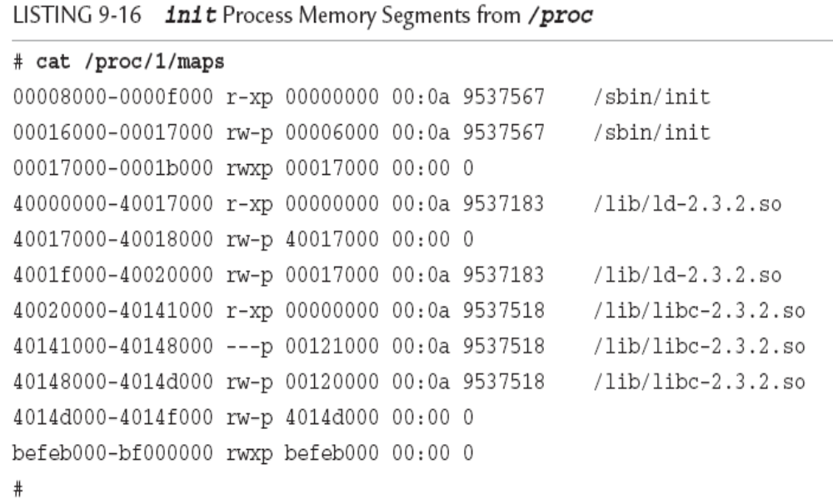
/proc file system
Embedded System

Slide 60
/proc file system
Other useful entries are listed for each process. The status entry contains information about the running process, including items such as the parent PID, user and group IDs, virtual memory usage, signals, and capabilities.
Some frequently used /proc entries are cpuinfo, meminfo, and version.
Many utilities have been designed for extracting and reporting information contained in the /proc file system. Two popular examples are top and ps, which every embedded Linux developer should be intimately familiar.
with.
Embedded System

Slide 61
sysfs
Like the /proc file system, sysfs is not representative of an actual physical device.
sysfs models specific kernel objects such as physical devices and provides a way to associate devices with device drivers.
We can get some idea of what kinds of objects are exported by looking directly at the directory structure exported by sysfs.
Embedded System

Slide 62
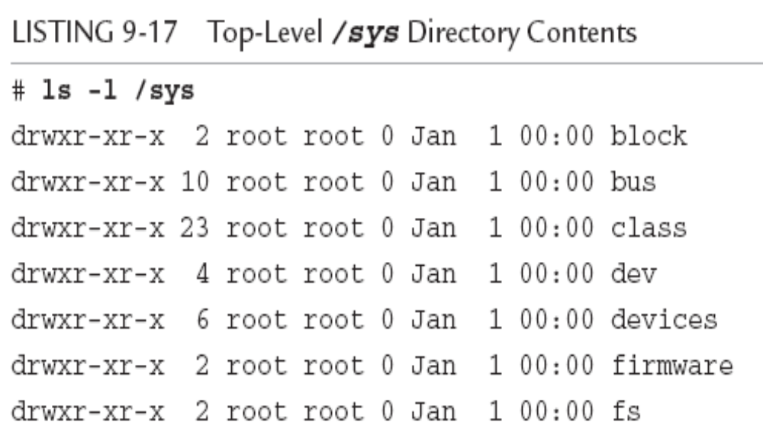
sysfs
Embedded System

Slide 63
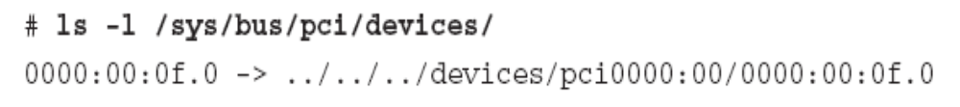
sysfs
sysfs provides a top-level subdirectory for several system elements, including the system buses. For example, under the block subdirectory, each block device is represented by a subdirectory entry.
Most of the information stored by sysfs is in a format more suitable for machines rather than humans to read.
Embedded System

Slide 64
Sysfs -systool
A useful utility can help you browse the sysfs file system directory structure. Called systool
  $ systool -b pci
  “Bus = “pci”
  0000:00:0f.0 8086:1229
Executed with no parameters, systool displays the top-level system hierarchy
Embedded System

Slide 65
Other File Systems
(1) Ramdisk
Ramdisk是将一部分固定大小的内存当作分区来使用。它并非一个实际的文件系统，而是一种将实际的文件系统装入内存的机制，并且可以作为根文件系统。将一些经常被访问而又不会更改的文件(如只读的根文件系统)通过Ramdisk放在内存中，可以明显地提高系统的性能。
在Linux的启动阶段，initrd提供了一套机制，可以将内核映像和根文件系统一起载入内存。
Embedded System

Slide 66
Other File Systems
(2)ramfs/tmpfs
The ramfs file system is best considered from the context of the Linux source code module that implements it.
Ramfs是Linus Torvalds开发的一种基于内存的文件系统，工作于虚拟文件系统(VFS)层，不能格式化，可以创建多个，在创建时可以指定其最大能使用的内存大小。(实际上，VFS本质上可看成一种内存文件系统，它统一了文件在内核中的表示方式，并对磁盘文件系统进行缓冲。)
Embedded System

Slide 67
Other File Systems
Ramfs/tmpfs文件系统把所有的文件都放在RAM中，所以读/写操作发生在RAM中，可以用ramfs/tmpfs来存储一些临时性或经常要修改的数据，例如/tmp和/var目录，这样既避免了对Flash存储器的读写损耗，也提高了数据读写速度。
Ramfs/tmpfs相对于传统的Ramdisk的不同之处主要在于：不能格式化，文件系统大小可随所含文件内容大小变化。
Tmpfs的一个缺点是当系统重新引导时会丢失所有数据。
Embedded System

